Slide 1
Maintaining standards in a changing market: the new EMT competence framework
Prague – November 3, 2017
Daniel TOUDIC
EMT Board member

Slide 2
THE EUROPEAN MASTERS IN TRANSLATION NETWORK

Slide 3

EMT past and present
DGT initiative 2006
Quality standard for translator training programmes (initially to meet EU needs)
Expert group 2007-2009
Summary report on "Competences for professional translators, experts in multilingual and multimedia communication" - January 2009
First network launched December 2009 (34 members)
Extended to 54 in 2010
Dec. 2013: renewal of applications
Second network launched September 2014 (63 members)
Next round of applications: autumn 2018

Slide 4
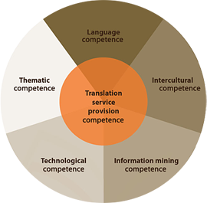
The EMT "Wheel of competences"
  http://ec.europa.eu/dgs/translation/programmes/emt/key_documents/emt_competences_translators_en.pdf

Slide 5
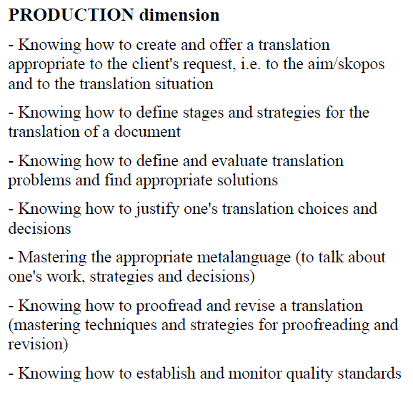
EMT competence framework: service provision

Slide 6
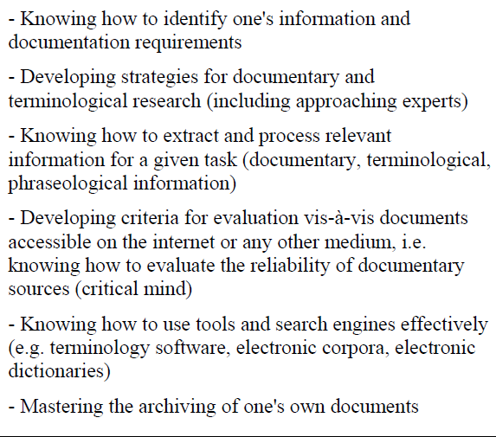
EMT competence framework: information mining competence

Slide 7
EMT impact on member universities
Application procedure requires proof of ability to deliver framework competences
Applicants required to think in terms of learning outcomes
Résumé | [Rédigez un résumé ou une introduction succincts pour chaque compétence, si nécessaire. Expliquez en quoi consiste, selon vous, le lien entre les compétences et les cours/modules et comment vous évaluez ces (sous-)compétences – 10 lignes maximum]
Compétence | ✓ | Cours/module | Méthodologie/instruments didactiques | Évaluation | Commentaires
Savoir créer et fournir une traduction qui répond aux exigences du donneur d’ouvrage, c’est-à-dire à la finalité/au skopos et au contexte de traduction
Savoir définir des étapes et des stratégies pour la traduction d’un document

Slide 8
EMT impact on member universities: challenges
N° of competences more suited to 2-year degree programmes
Practical experience requirement: depends on national and academic regulations
  dimension pratique
    Veuillez décrire la façon dont la formation pratique est intégrée dans votre programme, en précisant en quoi elle tient compte du contexte national/local (maximum 15 lignes).

Slide 9

EMT impact on universities: rewards
Greater awareness of professional requirements
Keeps programmes "on their toes« : Mid-term review
Sharing of good practice through network meetings + spin-off projects (Optimale, Agora, Transcert, OTCT…)
Cooperation with language industry: LindWeb, TEF, Surveys

Slide 10
A new EMT competence framework?
Current framework developped 2007-2009
  Technological advances (MT)
  Social media
  Diversfication of jobs and profiles (transcreation, tech. writing…)
  Organisation changes (fewer in-house translators)
Should language and culture competences be part of the framework?
Why does « translation competence » not appear as such? (cf. Pym, 2017)
Redundancies (between and within categories)
Ambiguous titles (e.g.: interpersonal dimension)

Slide 11
EMPLOYER AND EMPLOYEE PERSPECTIVES
COMPETENCE REQUIREMENTS:

Slide 12
Employer PERSPECTIVE

Slide 13
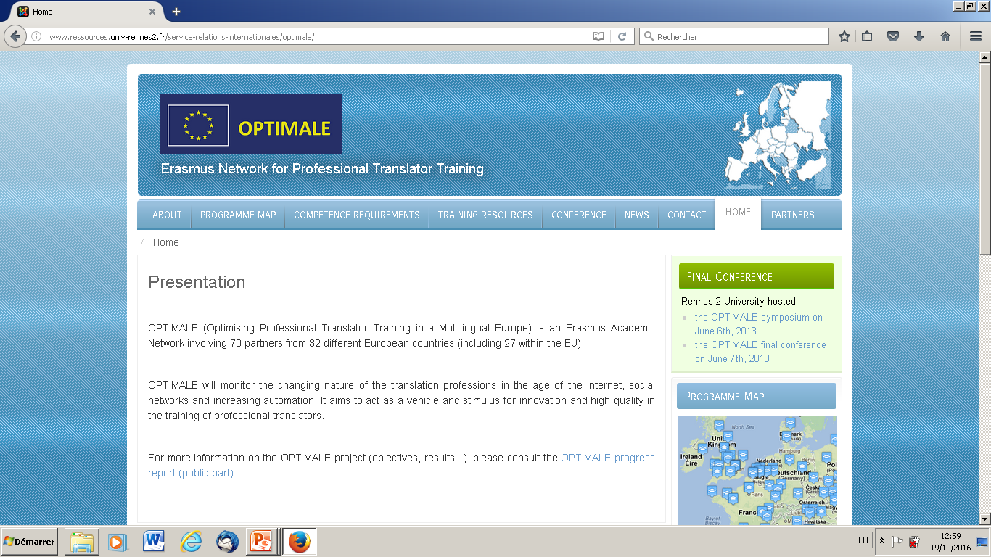

Slide 14
OPTIMALE: activities
Map of EU translator training programmes
Translation competence survey + report
Identification of « good practice » in professionally-oriented training
Case studies
Conferences + workshops
  3 plenary network conferences
  8 employer consultation workshops
  4 good practice workshops
  4 training of trainer workshops

Slide 15
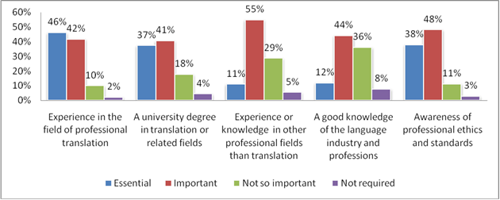
OPTIMALE Employer competence requirement survey
588 respondents across Europe
% rating specific professional competences

Slide 16
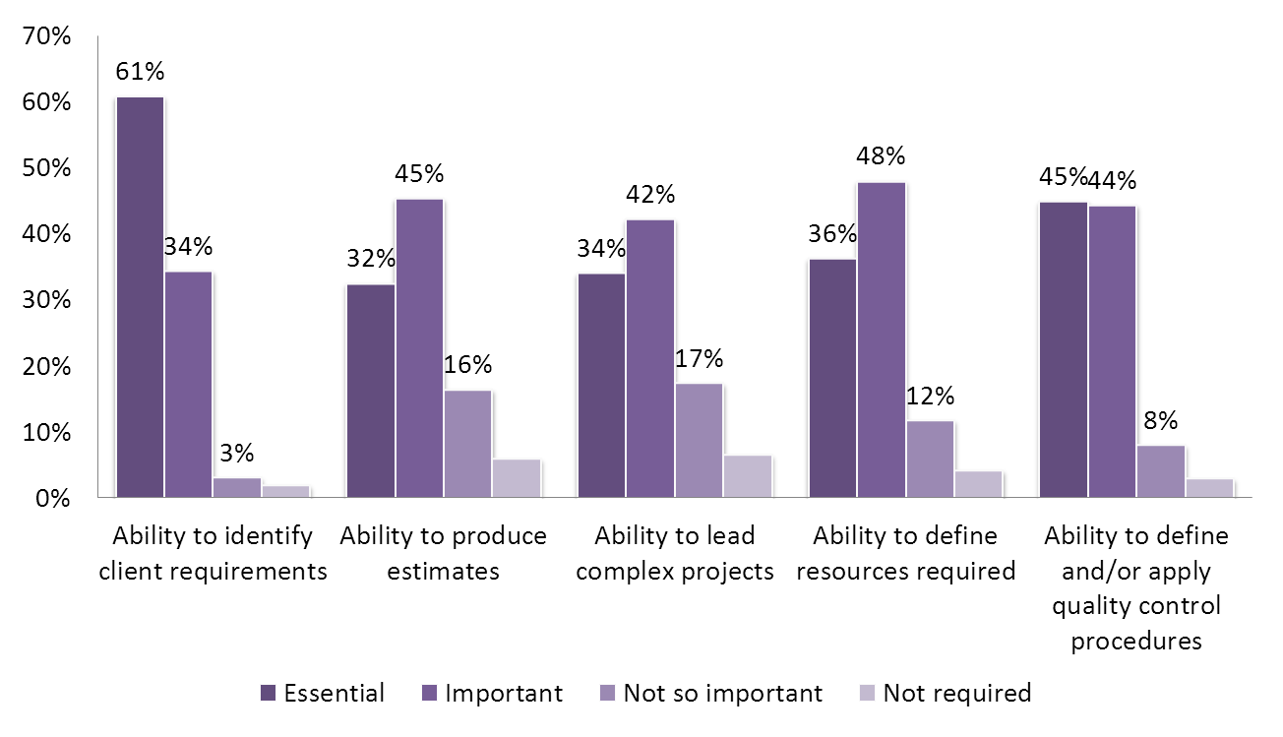
OPTIMALE Employer competence requirements survey

Slide 17
Optimale project survey of employer requirements (2011)
% of employers stating competence is important or essential

Slide 18
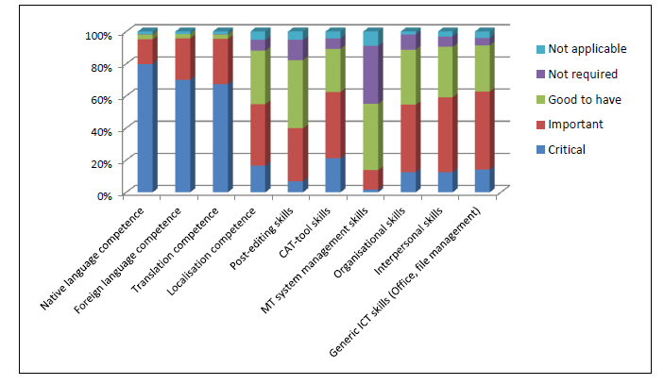
EUATC 2017 Survey
Language-related positions

Slide 19
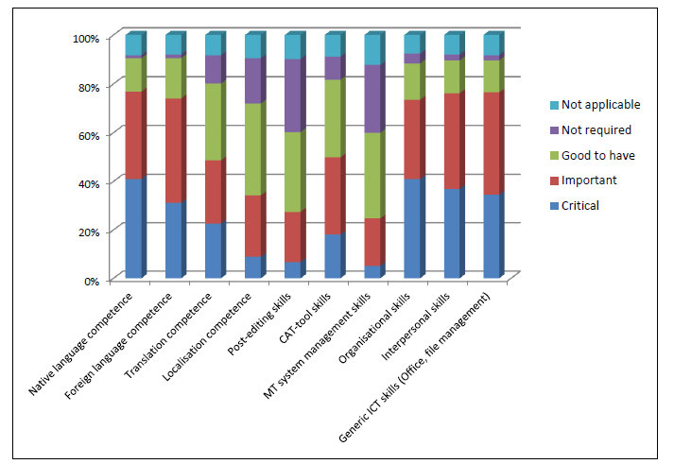
EUATC 2017 Survey
Other translation-related positions

Slide 20
TRANSLATION GRADUATE PERSPECTIVE

Slide 21
EMT graduate employment survey 2016
Graduates with Masters in Translation from EMT member universities 2010-2015
29 questions (including 3 open questions)
Over 1700 responses from 22 countries
  80% in employment, 8.5% seeking employment
  56% employed in the private sector
  15% employed in the public sector
  25% self-employed

Slide 22
EMT graduate survey – job sector

Slide 23
EMT graduate survey: by job title

Slide 24
EMT graduate survey – competences

Slide 25
EMT graduate survey - competences

Slide 26
Defining a new competence framework

Slide 27
Basic principles
Predicated on
  Translation as a professional field
  Translation as a process
Aim: to enhance graduate employability
NOT
  a comprehensive model of translation competence
  a common curriculum or syllabus
Common set of learning outcomes
  Knowledge + skills = competences

Slide 28

Key issues
Programme diversity
Working languages
Language competence and cultural knowledge
« Translation » competence
« Technological » competence
Personal and professional skills

Slide 29
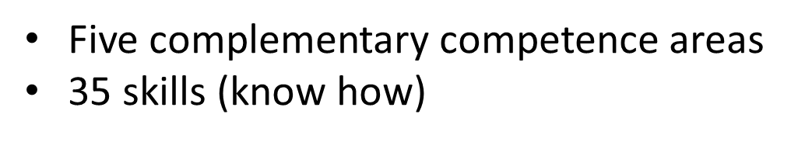
EMT Competence Framework

Slide 30
Key changes: competence areas
6 areas
5 areas
⇒

Slide 31

Language and culture
Pre-requisites
Advanced level of knowledge and skills in working languages (C2/C1 in CEFR)
Proof of level on admission and completion of Master’s

Slide 32

Translation competence
Includes strategic, methodological and thematic competence
Translation as a process, from document reception and analysis to quality control
Domain-, media- and situation-specific translation
Post-editing and MT awareness

Slide 33
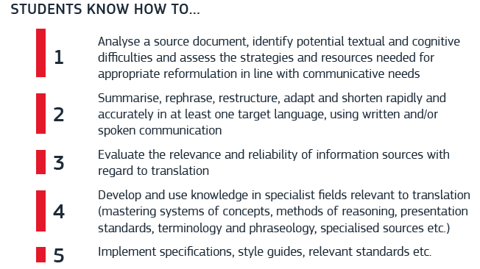
Translation competence

Slide 34


Translation competence
14 skills, including:
  Translating from and into different media
  Translating in intercultural contexts (written and spoken)
  Summarizing / synthesizing
  Text drafting
  Pre-editing
  Checking, reviewing and/or revising
  Understanding and implementing QC
  Understanding and implementing PE

Slide 35
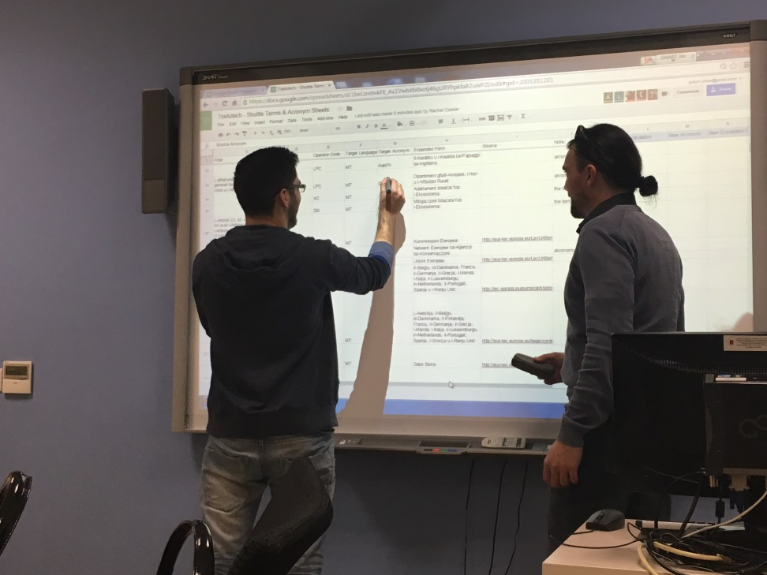
Technology-based competence
Use relevant IT applications including office software
Make full use of search engines, CAT and CATA tools
Pre-process, process and manage all kinds of files
Master basics of MT and assess relevance of different systems
Apply other tools, e.g. translation workflow management

Slide 36
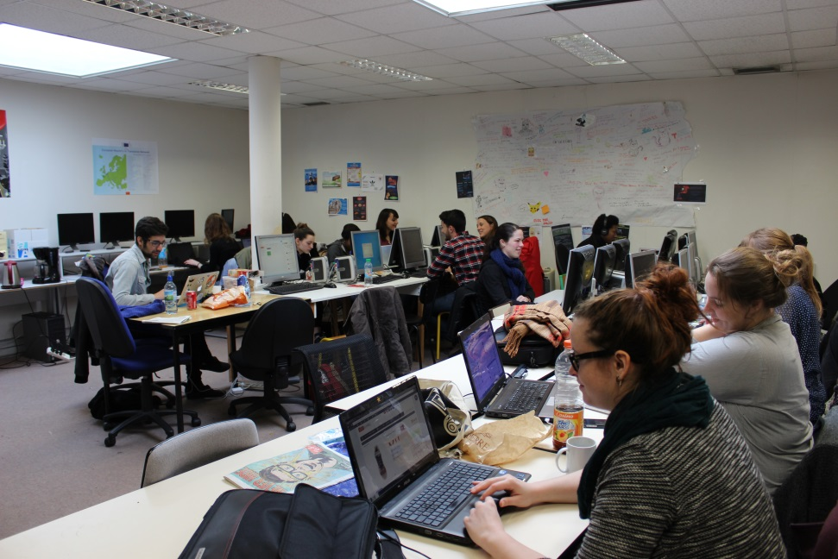
Personal and interpersonal competence
Plan and manage time, stress, work and budget
Comply with deadlines, instructions, specs, style guides, etc.
Work in teams
Work in multicultural, multilingual environments
Use social media responsibly
….

Slide 37

Service provision competence
Monitor new market requirements
Finding and holding on to clients
Understand client requirements
Negotiate rates, deadlines, conditions…
Manage translation projects
QA
Standards and ethics

Slide 38


EMT competences

Slide 39
To find out more…
https://ec.europa.eu/info/resources-partners/european-masters-translation-emt_en
http://www.ressources.univ-rennes2.fr/service-relations-internationales/optimale/
http://www.otct-project.eu
https://www.euatc.org/eu-projects/item/189-lind-web-platform

Slide 40
THANK FOR YOUR ATTENTION!
daniel.toudic@univ-rennes2.fr

